Slide 1
Sigmoid neuron, FFNN

Slide 2
Sigmoid neuron
Sigmoid neurons are similar to perceptron , but they are slightly modified such that the output from the sigmoid neuron is much smoother than the step functional output from perceptron.

Slide 3
perceptron model and its limitations
Perceptron model takes several real-valued inputs and gives a single binary output.
In the perceptron model, every input xi has weight wi associated with it.
The weights indicate the importance of the input in the decision-making process.
The model output is decided by a threshold Wₒ if the weighted sum of the inputs is greater than threshold Wₒ output will be 1 else output will be 0.
In other words, the model will fire if the weighted sum is greater than the threshold.

Slide 4
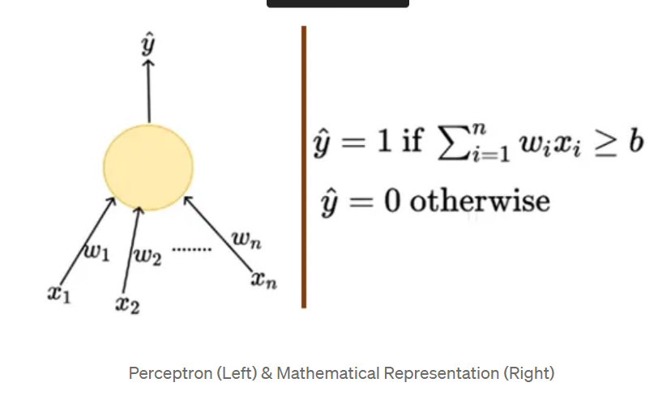
perceptron model and its limitations
From the mathematical representation, we might say that the thresholding logic used by the perceptron is very harsh

Slide 5
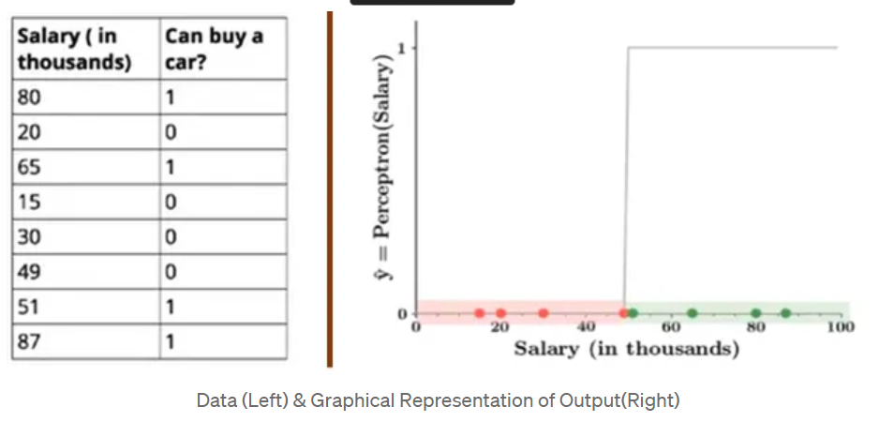
harsh thresholding logic - example
Consider the decision- making process of a person, whether he/she would like to purchase a car or not based on only one input X1 — Salary and by setting the threshold b(Wₒ) = -10 and the weight W₁ = 0.2.
The output from the perceptron model will look like in the figure.

Slide 6
harsh thresholding logic - example
Red points indicates that a person would not buy a car and green points indicate that person would like to buy a car.
Isn’t it a bit odd that a person with 50.1K will buy a car but someone with a 49.9K will not buy a car? The small change in the input to a perceptron can sometimes cause the output to completely flip, say from 0 to 1.
This behavior is not a characteristic of the specific problem we choose or the specific weight and the threshold we choose.
It is a characteristic of the perceptron neuron itself which behaves like a step function. We can overcome this problem by introducing a new type of artificial neuron called a sigmoid neuron.

Slide 7
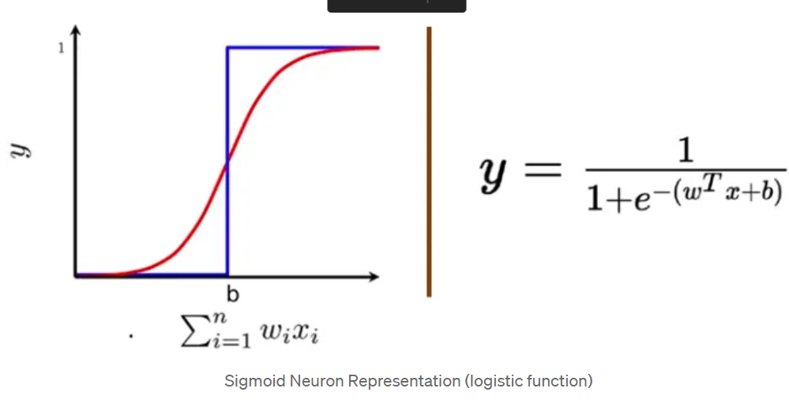
Sigmoid neuron
Introducing sigmoid neurons where the output function is much smoother than the step function.
In the sigmoid neuron, a small change in the input only causes a small change in the output as opposed to the stepped output.
There are many functions with the characteristic of an “S” shaped curve known as sigmoid functions. The most commonly used function is the logistic function.
We no longer see a sharp transition at the threshold b. The output from the sigmoid neuron is not 0 or 1.
Instead, it is a real value between 0–1 which can be interpreted as a probability.

Slide 8
We no longer see a sharp transition at the threshold b. The output from the sigmoid neuron is not 0 or 1.
Instead, it is a real value between 0–1 which can be interpreted as a probability.

